Slide 1
Altera DE 2 demo instructions for Kactus 2 Design environment
Juha Arvio, Lauri Matilainen
Tampere University of Technology
November 2011

Slide 2
Intro
This demo describes step by step how to generate top-level VHDL and Quartus project from Kactus2 DE
This very simple demo is designed for Altera DE2 development board.
SoC instantiates two components: sig_gen and port blinker.
Sig_gen reads switch[17] from DE2 board and activates port_ blinker to blink ledr[0] in DE2 Board.
Reset is located in SW[0]

Slide 3
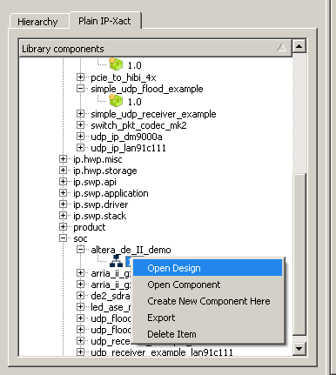
1. Open demo design

Slide 4
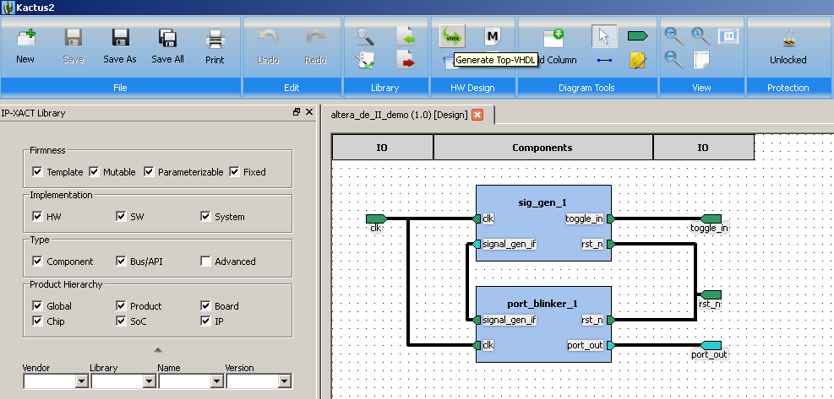
2. Generate top-level VHDL
Remember to unlock the design

Slide 5
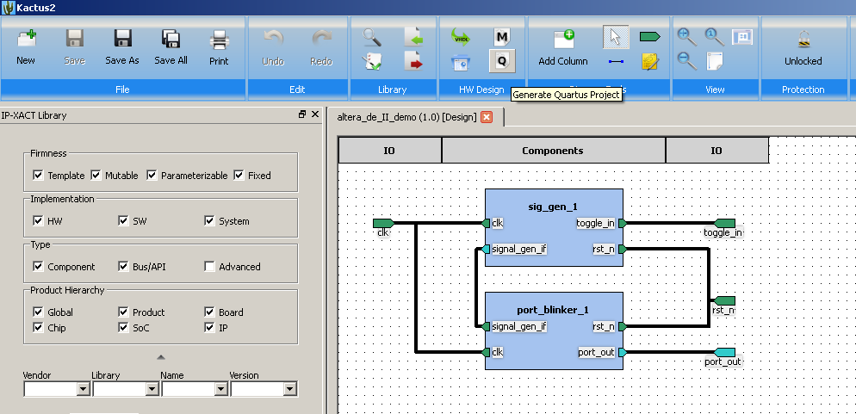
3. Generate Quartus Project

Slide 6
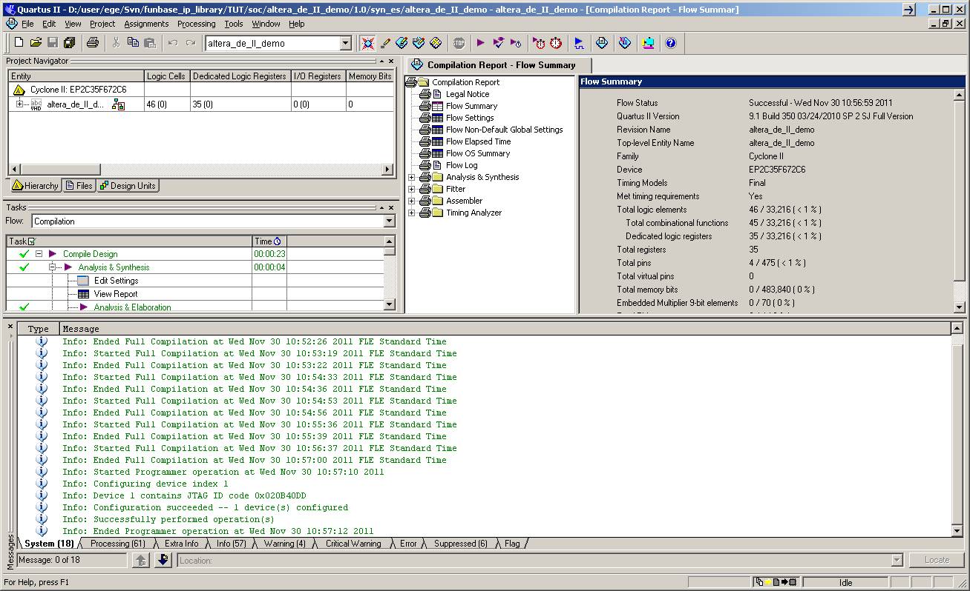
4. Compile and synthesize created project with Quartus

Slide 7
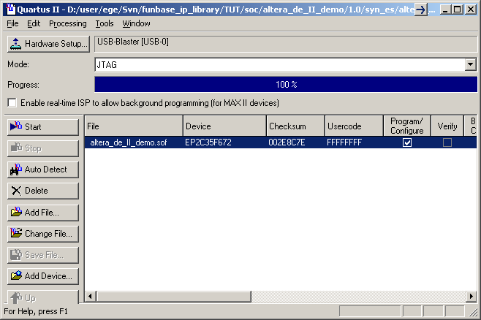
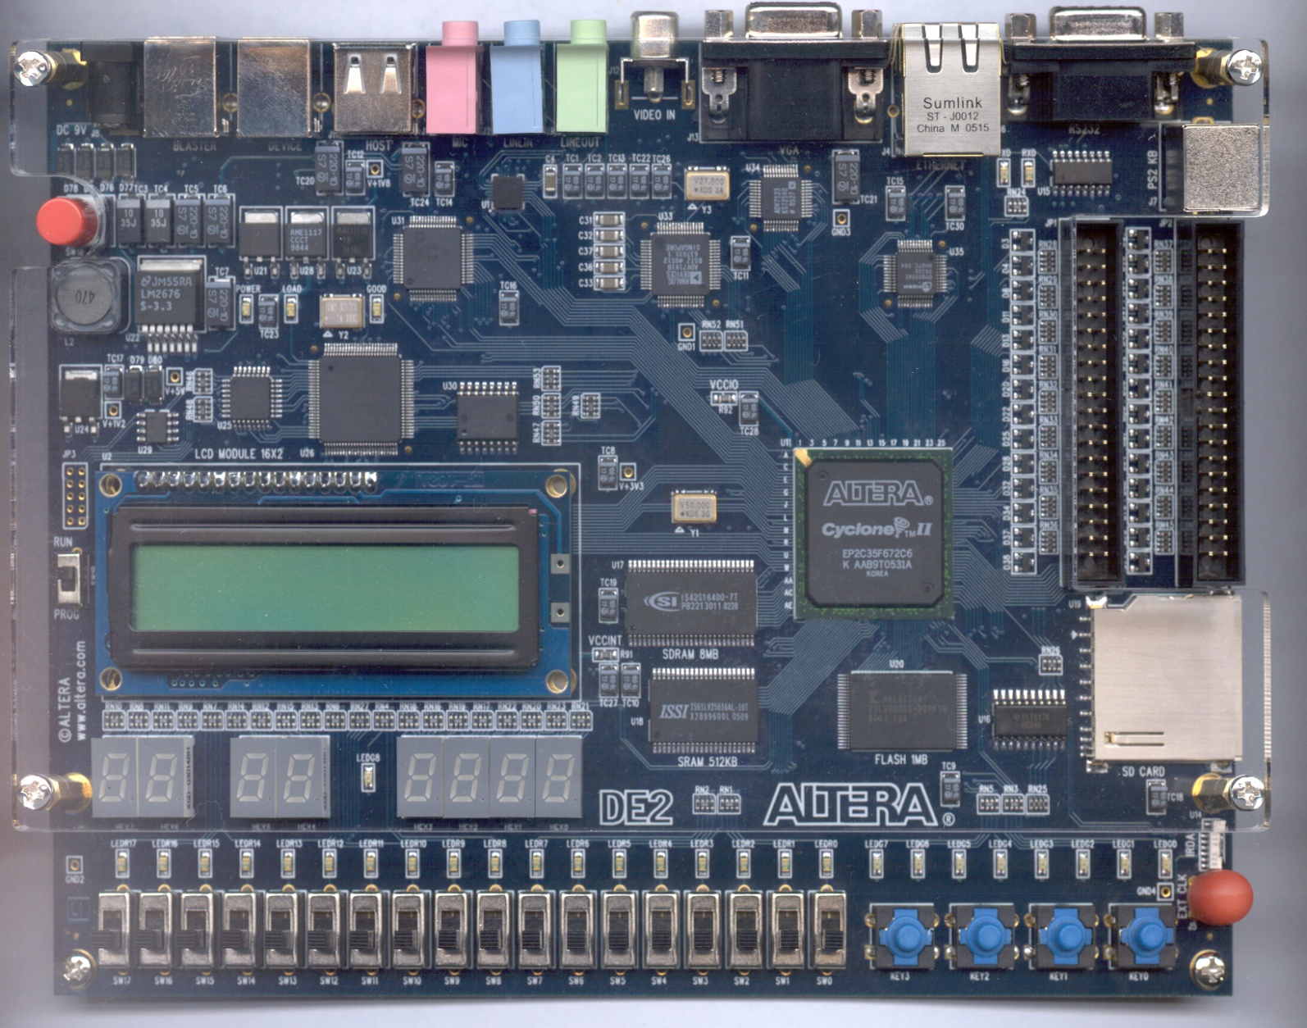
5. Program the FPGA
BLINKING LED
RESET
TOGGLE
(sig_gen will detect rising edges in this switch)

Slide 8
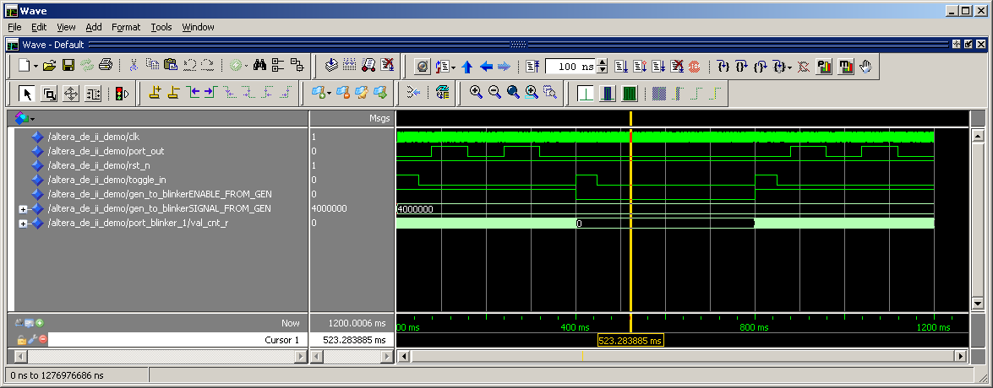
6. You can also simulate with Modelsim
Go to dir sim
vsim –do compile_all.do &
Compile_all.do is generated by Kactus
do sim.do
Simulation takes a while and then you should see something like this:
1. Leds blinks (twice)
2.Rising edge of switch inverts the enable to 0. Blinking stops.
3.Another rising edge of switch enables blinkin again.

Slide 9
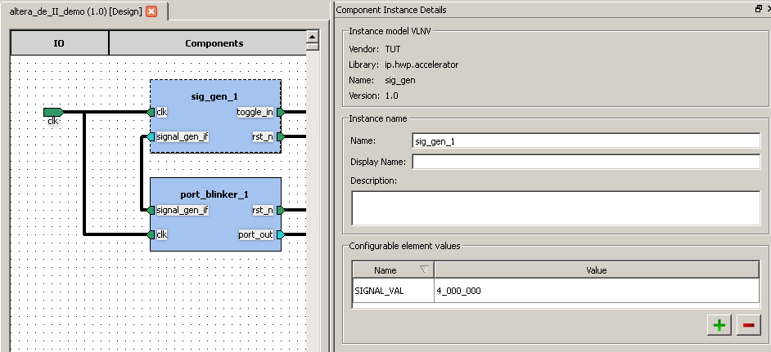
Summary
Everything should go smoothly all the way to FPGA
You may edit generator’s model parameter SIGNAL_VAL to change blinking period

Slide 10
To learn more
Browse through the Kactus menus
E.g. Open the component view altera_de_ii_demo and
You’ll see the general description, definitions for files, ports etc.
You might need to unlock the components
Open the XML files. They are human-readable (although may seem cryptic at first look)
altera_de_II_demo.1.0.xml
altera_de_II_demo.design.1.0.xml
Take also a look at generated top-level VHDL altera_de_II_demo..vhd

